Slide 1
TT231 – DevOps Process demonstration
23 December 2019

Slide 2
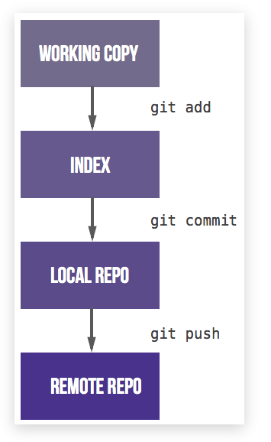
Key things in Git
Unlike SVN, Git consist of “Local Repo” and “Remote Repo”
Most important commands in GIT:
“Fetch”:
downloads commits, files, and refs from a remote repository into your local repo.
Fetching is what you do when you want to see what everybody else has been working on.
“Pull”:
The git pull command is used to fetch and download content from a remote repository and immediately update the local repository to match that content.
Merging remote upstream changes into your local repository is a common task in Git-based collaboration work flows.

Slide 3
Key things in Git
Unlike SVN, Git consist of “Local Repo” and “Remote Repo”
Most important commands in GIT:
“Push”:
The git push command is used to upload local repository content to a remote repository.
Pushing is how you transfer commits from your local repository to a remote repo.
“Commit”
The git commit command captures a snapshot of the project's currently staged changes.
Committed snapshots can be thought of as “safe” versions of a project
“Merge Request”
To raise a merging code from a branch to another branch

Slide 4

TT231 DevOps process & components explanation
Versioning Control House Rules Overview
5 type of Branches
Master (Permanent)
ALWAYS Production Code
Only check in from Release
Release (Permanent)
For developers to work together and consolidating all the code before release
Code stay here before deployed to production (then merge into Master)
For testing
Develop (Permanent)
For developers to work together on all the unreleased changes/features
Features
A features per branch
To be removed after merge into development
Can only merge into Development
Prefix of “feature_”
Hotfixes
A fixes per branch
For issues that required faster/immediate solution to production / testing
Can only merge into Development
Prefix of “hotfix_”

Slide 5
TT231 DevOps process & components explanation
Versioning Control House Rules Overview
Local Changes
Commit
Push
Raise merge request
Ok?
Prepare for Release
master
V1.0.2
release
development
feature_mainpage
feature_websocket_dev
Check in EVERY TIME after a feature/hotfix branch is completed.
Check in EVERYDAY before you leave if haven’t finished the works(commit & push to remote git server)

Slide 6
Versioning Control House Rules
MASTER branch is STABLE production release for ALL TIME
RELEASE branch is for features that are released for testing
STRICTLY no direct COMMIT to MASTER, RELEASE, DEVELOP branch
After feature is completed, raise MERGE REQUEST to request merging your changes to DEVELOP
Only DEVELOP branch can merge into RELEASE
Only RELEASE branch can merge into MASTER
Team Lead has to manage testing and production release by controlling merge requests on MASTER and RELEASE
Commit your code EVERY TIME after a feature/hotfix branch is completed.
Commit your code minimally EVERYDAY before you leave if haven’t finished the works(commit & push to remote git server)
Approve and merge by Merge Request Raiser is PROHIBITED.

Slide 7
TT231 DevOps process & components explanation
Source Code Quality Process
Dependency Management
Developing
Commit to Branch
Releasing
Quality Ok?
Failed.
Feedback on
code quality.
TT231 Artifacts Repository
Public Artifact Repository
1.) Get depending library
Offline retrieve, scan, deploy
Dependent Libraries
Compilation Trigger
Dependent Libraries
2.) Compile
Application
3.) Release internally for internal referencing

Slide 8
TT231 DevOps process & components explanation
Proposed CI/CD Process Overview
Developed
Released
Deployed
master
V1.0.2
release
development
feature_mainpage
Features accepted.
Tested.
AFTER Release deployed to Production & DR env.
Developer released.
CI/CD automatic compile and release to dev env.
Ready for client testing
CI/CD automatic compile and release to UAT env.

Slide 9
End
Restricted

